Slide 1
Beginning Beekeeping
How to Survive Your First Week
By Tim

Slide 2
Topics:
Set Yourself Up For Success
Know Local Regs and Local Critters
Get the Right Bees
Get the Right Equipment
Initial Setup
Installing Your Package
Feeding Your Package
Initial Hive Check
Recognizing workers, drones, and queens
Identifying eggs, larvae, pollen, and nectar

Slide 3
New Beekeeper Calendar
January: Attend TFB Symposium, watch 10 Youtube videos
February: Order Bees, take Beekeeping Class, watch 15 Youtube videos
March: Purchase Hive, Accessories & Protective Clothing, watch 20 Youtube videos
April: Bees Arrive!
Day 1: Pick up and Install Package
Day 5: Release Queen
Day 12: First Hive Check

Slide 4
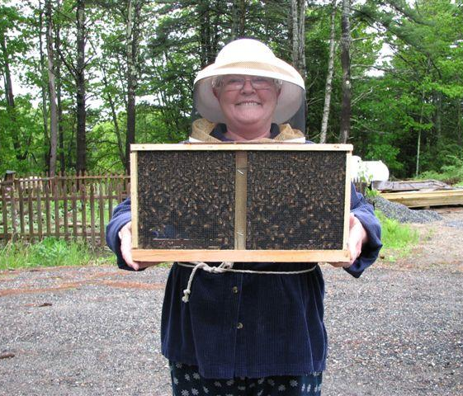
Two Hives are Better Than One!
Best start: two 4lb packages
Advantages of two hives:
The ability to share frames, resources, and combine (if needed) makes you more self sufficient.
Comparing the progress of different hives speeds up your learning process.
If you can only have one hive, try to locate it near other hives you can compare too.

Slide 5
Be Aware of Local Regulations
(Including HOA)
Anchorage Regs:
i. Colonies of Apis mellifera shall be managed in such a manner that their flight path to and from the hive will not bring them into contact with people on adjacent property. To accomplish this, colonies shall be:
(A) At least 25 feet from any lot line not in common ownership; or
(B) Oriented with entrances facing away from adjacent property; or
(C) Placed behind a fence at least six feet in height and extending at least ten feet beyond the hive in all directions.
ii. No more than four hives shall be placed on lots smaller than 10,000 square feet.

Slide 6
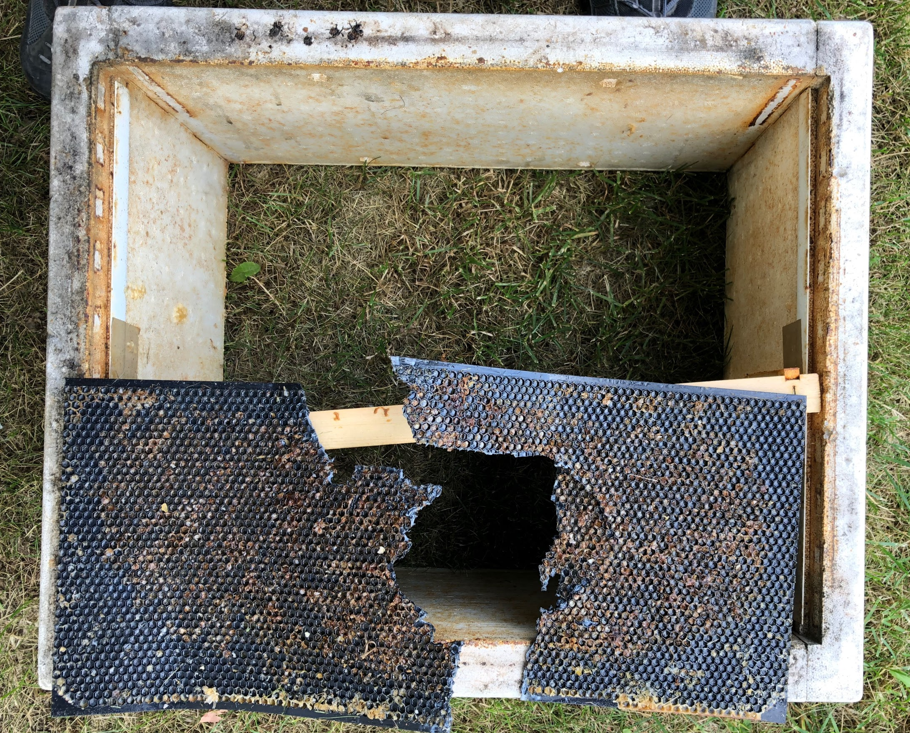
Don’t Share Your Bees with Bears

Slide 7
The Best Bees for Alaska
Russians * Carniolans * Italians

Slide 8
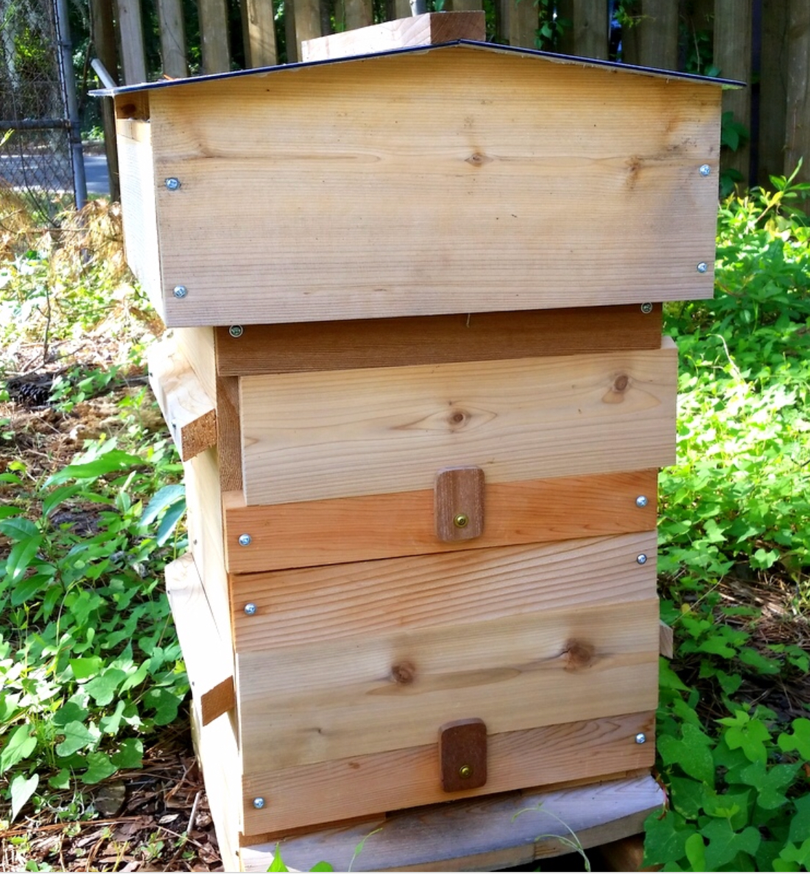
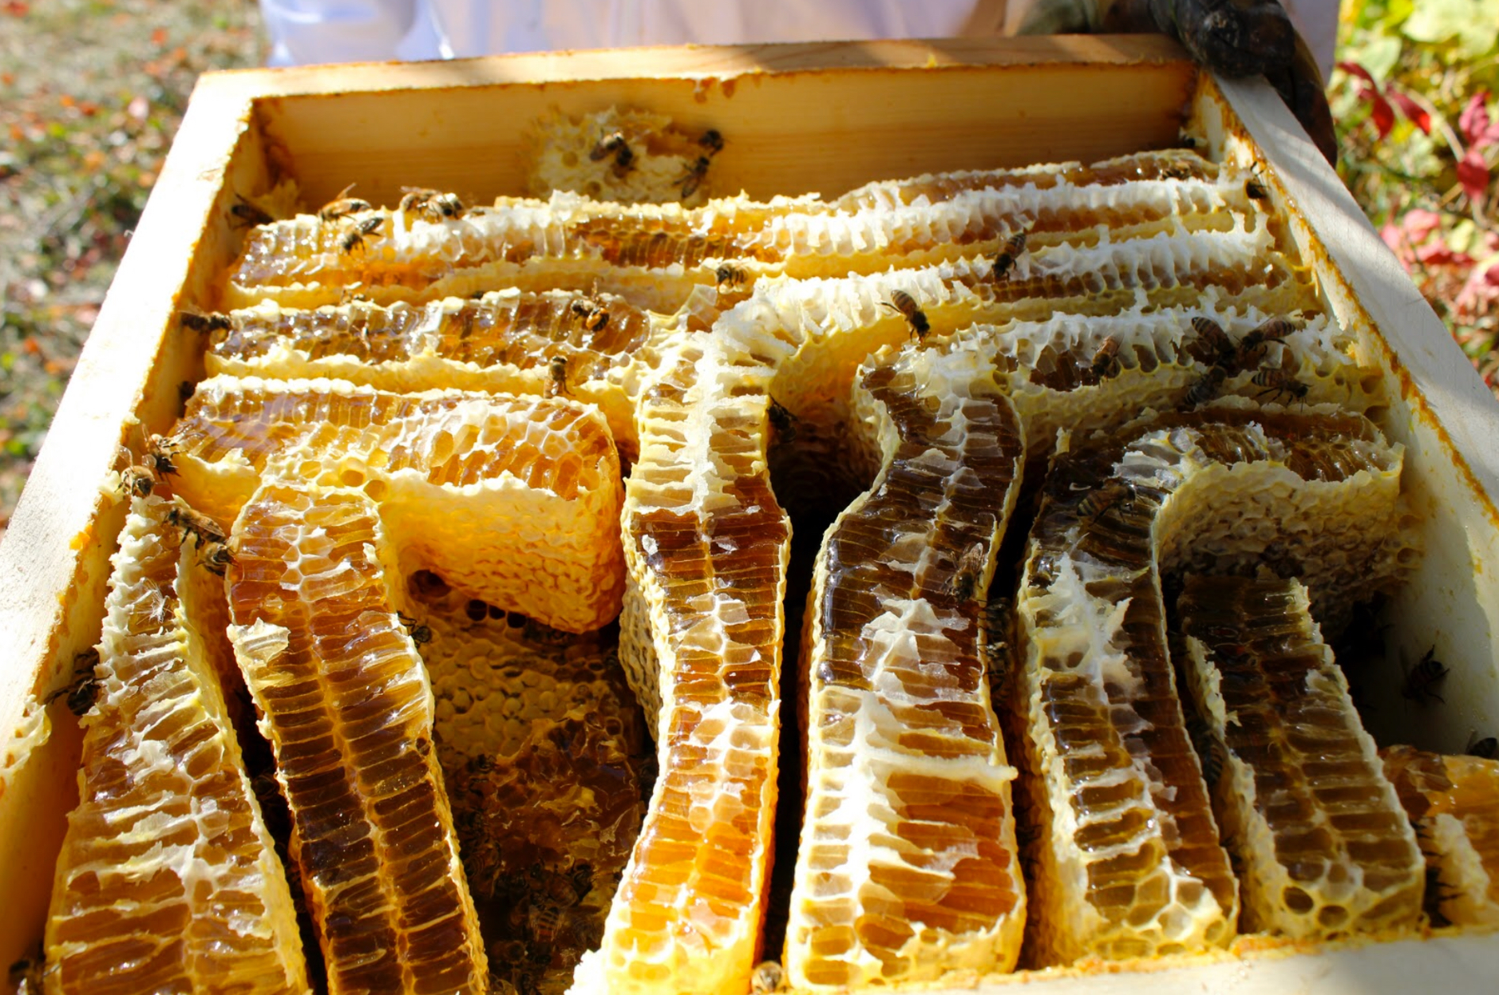
Warre Hive
External View
Internal View

Slide 9
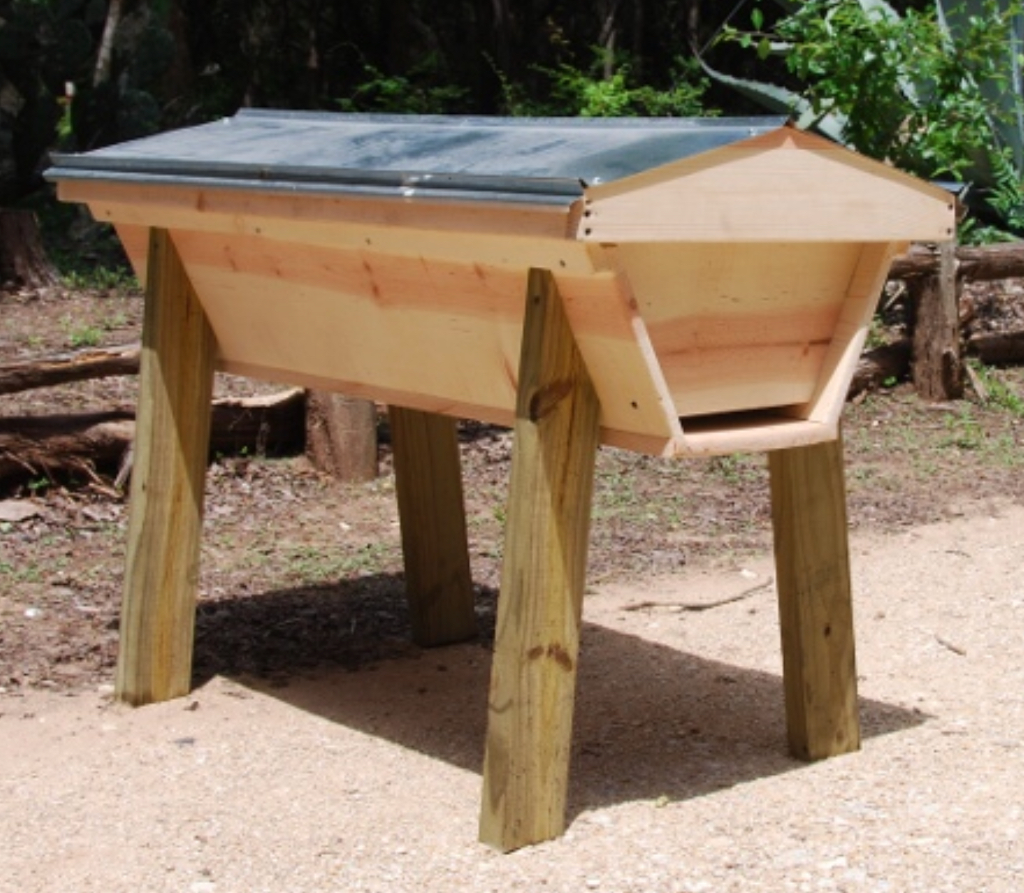
Top Bar Hive
Pros:
No lifting boxes
Removable combs (usually . . .)
Easy to build
Less disturbance to the colony
Cons:
Bees prefer to move vertically in winter (can only move horizontally)
Lots of cross comb building
Less common, frame and box size is not standardized
No supports on sides or bottom
Comb must be destroyed to harvest honey

Slide 10
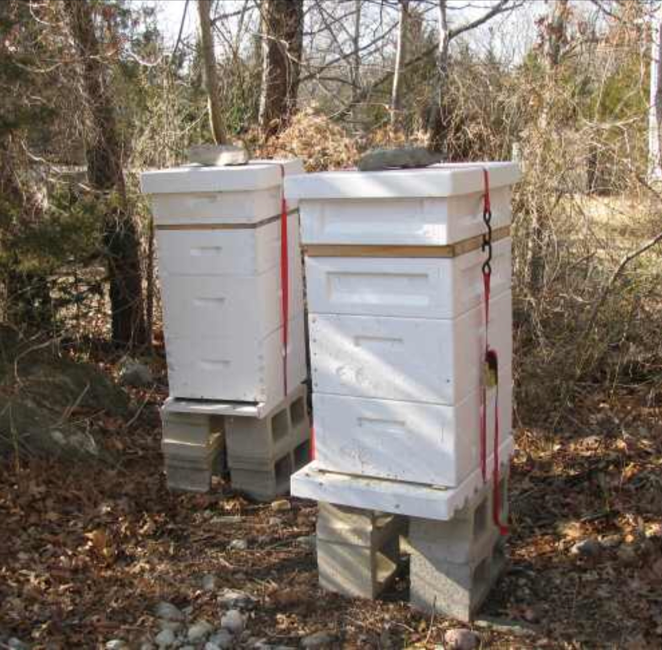
Langstroth Hives in High Density Polystyrene
Pros:
Removable frames make inspections/ manipulations much easier.
Standardized sizes widely available
Larger box size provides plenty of room for colony growth .
High density polystyrene helps the colony retain heat.
Con:
When full of honey, Langstroth boxes are heavy (60-90 lbs).

Slide 11
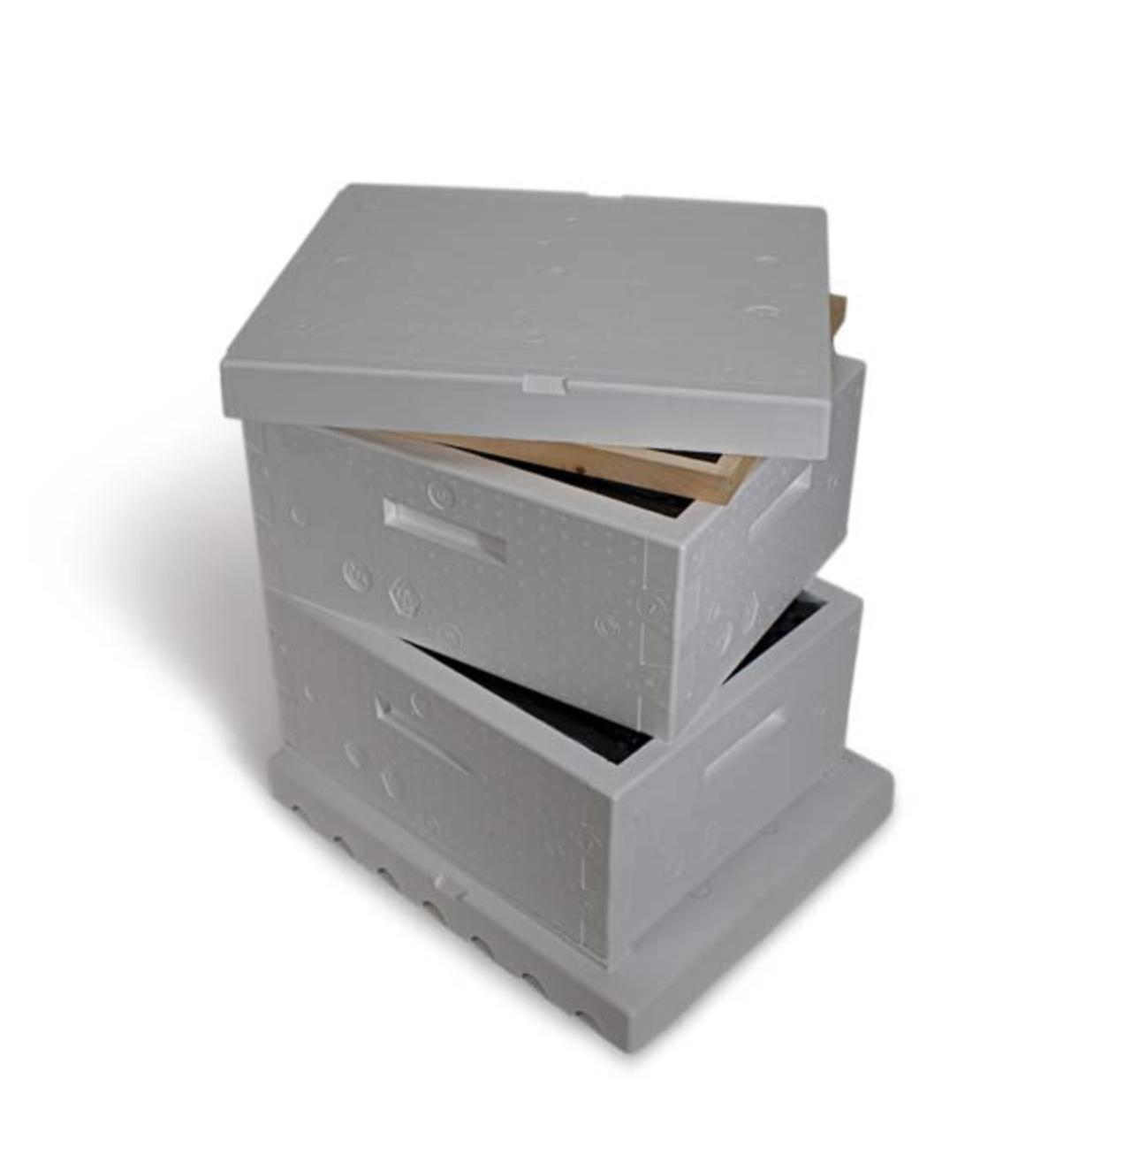
Minimum Necessary Hive Parts to Begin
1 Outer Cover (Lid)
1 Inner cover
2 Hive Boxes
20 Frames
1 Bottom Board
Not pictured:
Hive Stand
1 Jar Feeder
As population grows, you may need 1-2 more boxes.

Slide 12
Waxing Plastic Foundation
The bottom frame has a thin layer of wax from the factory. This is often not enough to convince the bees to draw comb on the entire frame.
Extra wax is painted on the top frame.
Two main benefits:
Fully drawn out frames decrease likelihood of swarming.
Extra wax greatly reduces cross combing (that you’ll have to cut out later).

Slide 13
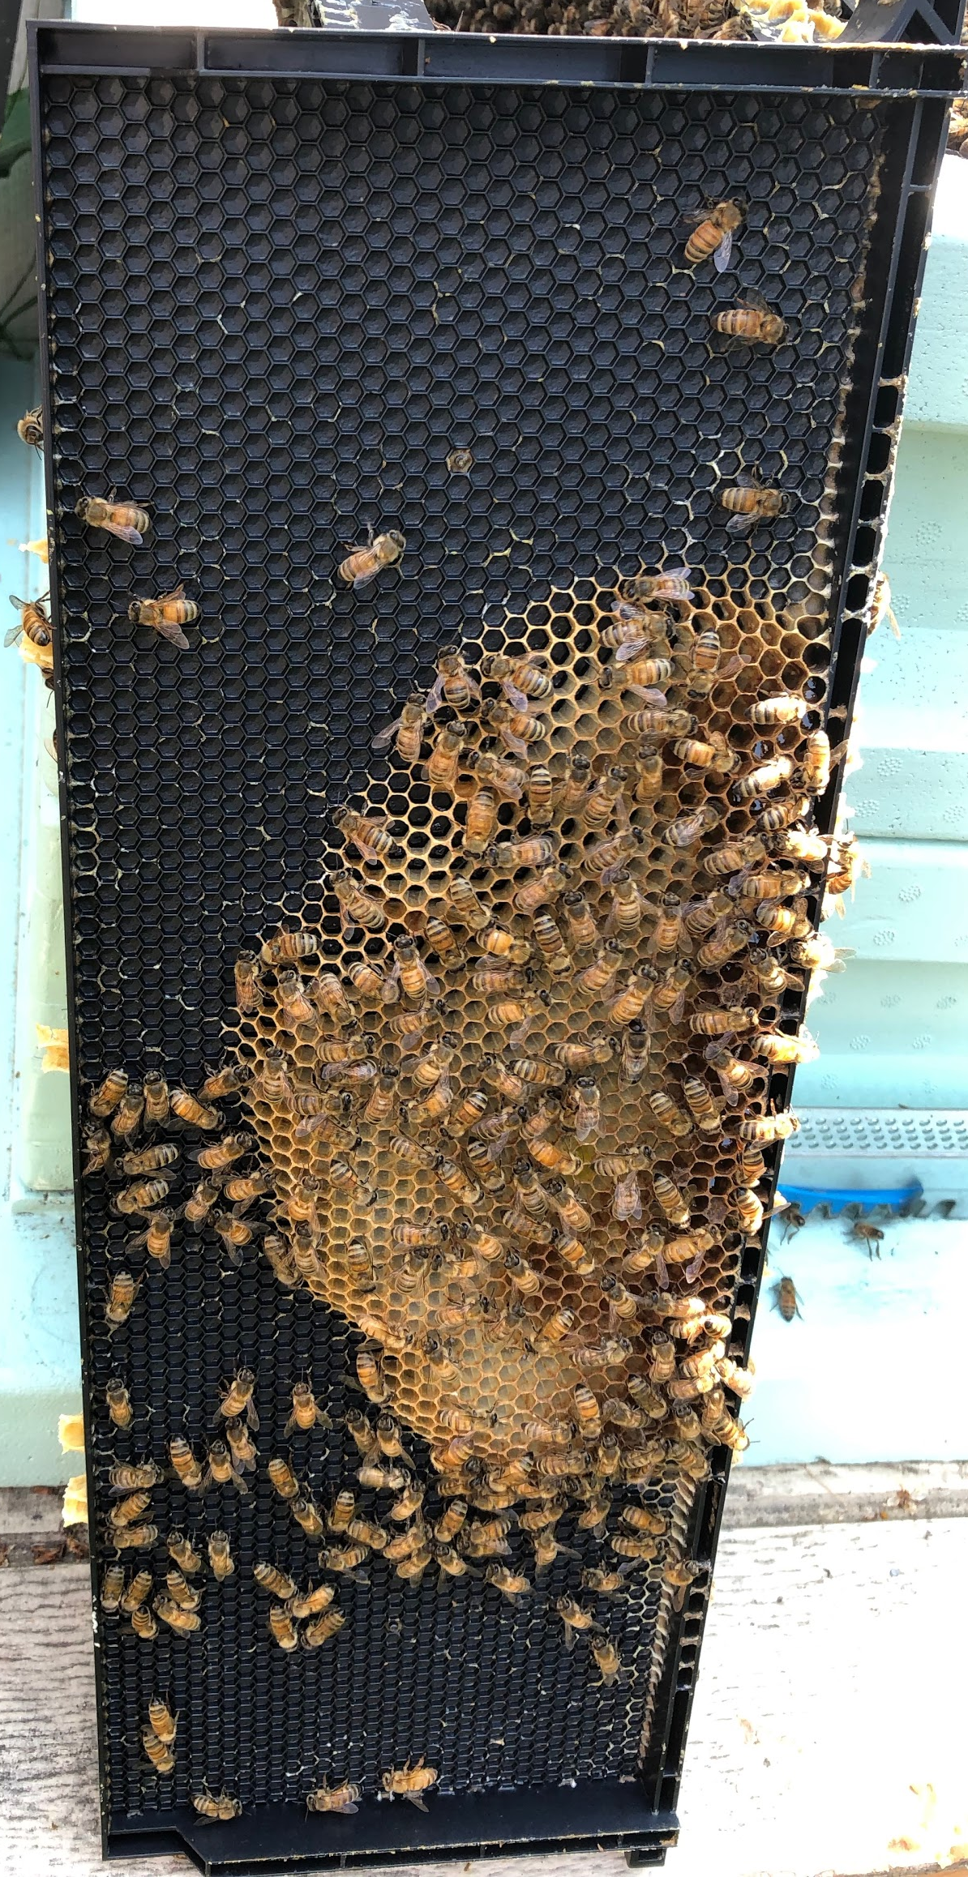
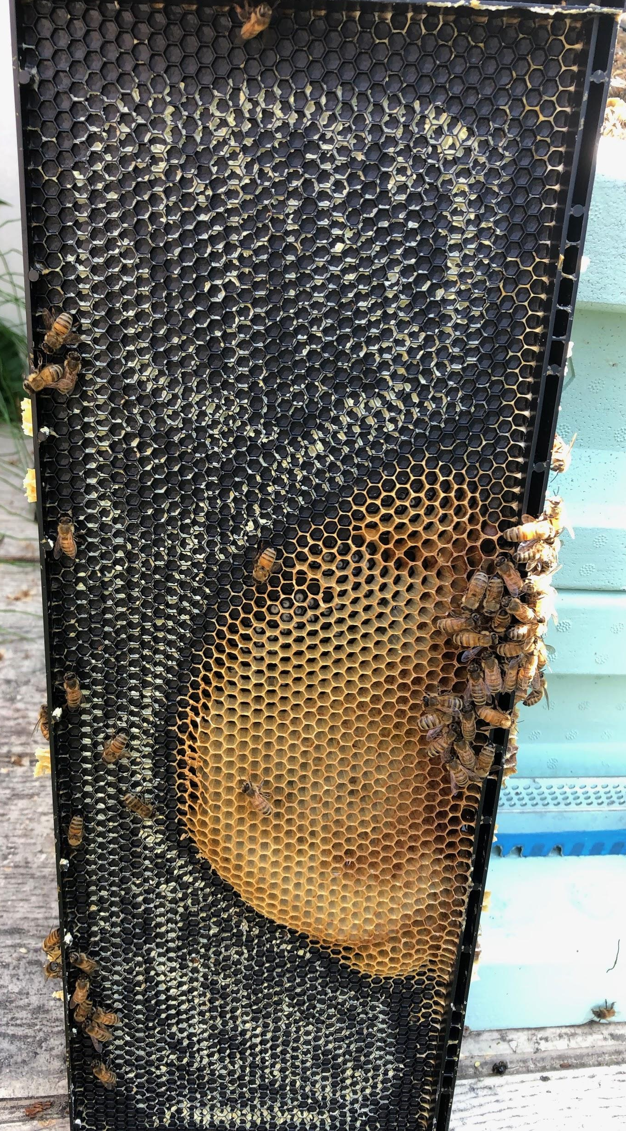
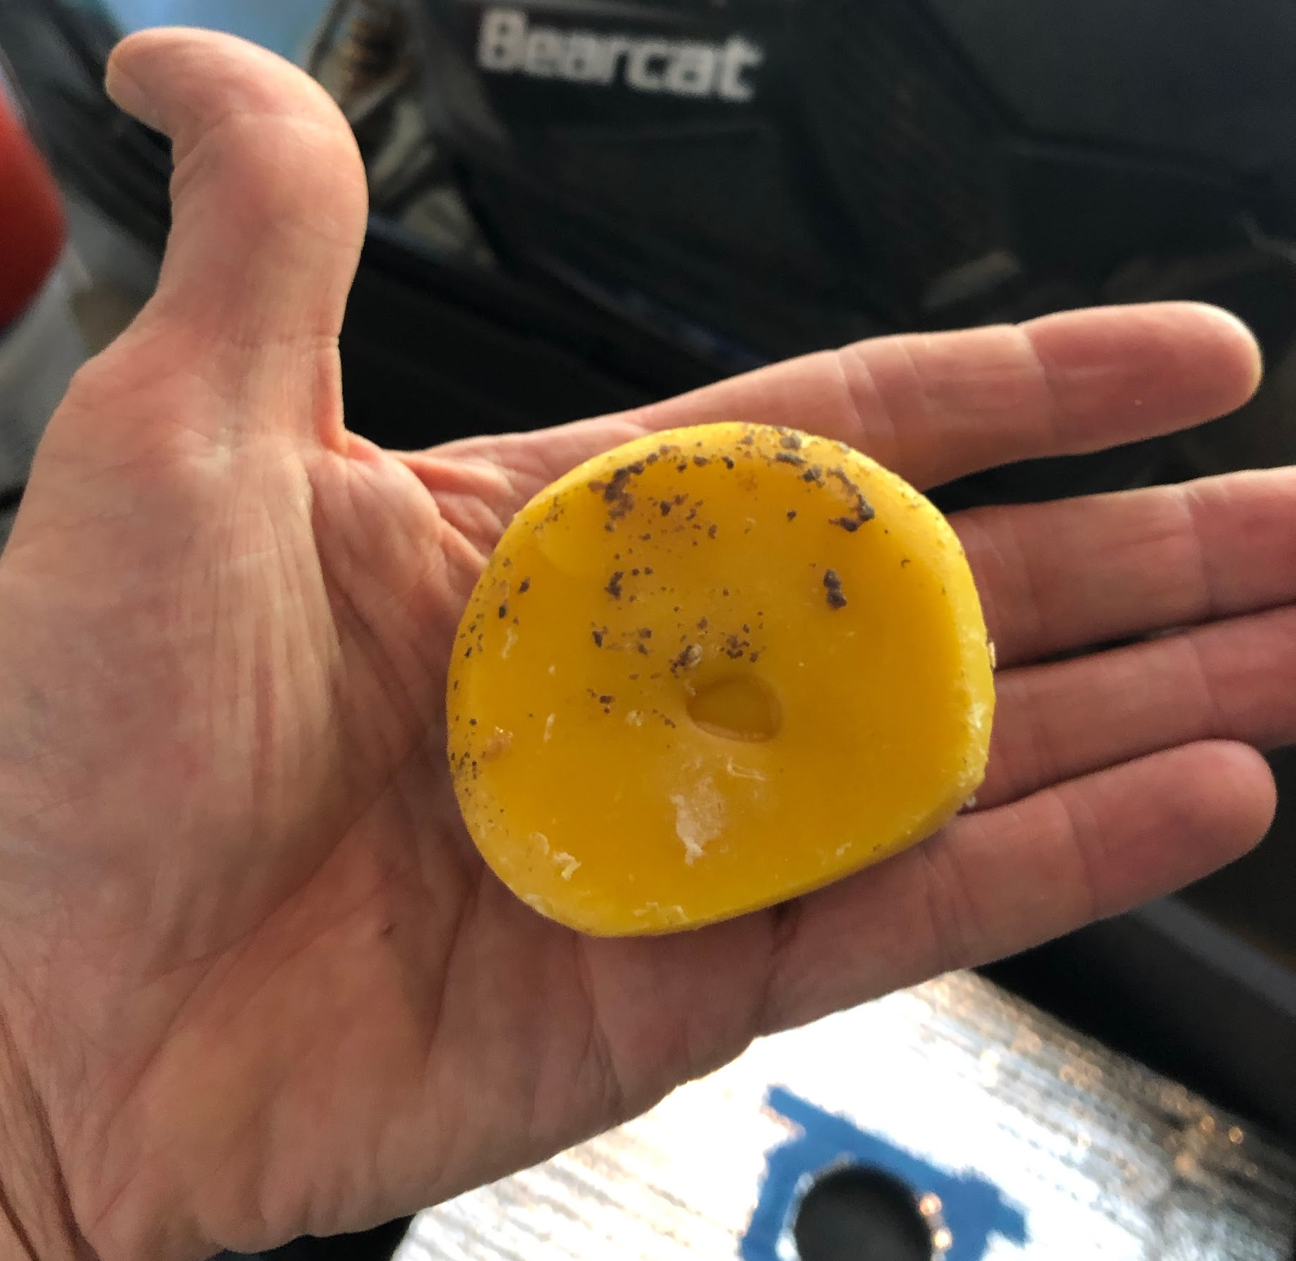
Waxing Plastic Foundation
Sometimes bees don’t take the hint. They chewed the wax off of this previous waxed frame, then refused to draw out the rest.
I used a homemade bar of comb to coat the frames in the field, and two weeks later this frame was fully drawn.
Tip: Save all of your old comb (burr, brace, cross). Smush it into a ball after inspections, and stick the ball on your hive or in a Costco nut jar.
Melt it down at home (per Youtube videos) to create a bar of wax.

Slide 14
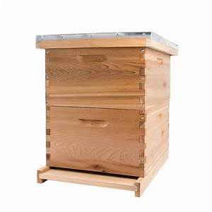
Start With One Brood Box
A single box for the bees to raise brood and store resources is better because:
Less space makes it easier for the colony to control heat and humidity, which in turn allows them to raise more brood and build comb faster.
When given multiple boxes from the start, they may ignore the outside frames completely, and build comb only on the middle frames of both boxes. Adding insult to injury, they may then swarm.
Fewer frames make inspections much easier.
10 plastic foundation frames.
Recommend “small cell” foundation, with extra wax.
1 top box to enclose the jar feeder.
Alternative: 1 box with an internal frame feeder.

Slide 15
You’ll Need More Boxes
As your colony grows, they’ll need to expand into more boxes. By late summer you may need:
Brood Nest: 2 deeps boxes or 3 mediums.
Honey Super: 1 medium.
Plan ahead! Your beekeeping supply store may be sold out if you wait until the last minute.

Slide 16
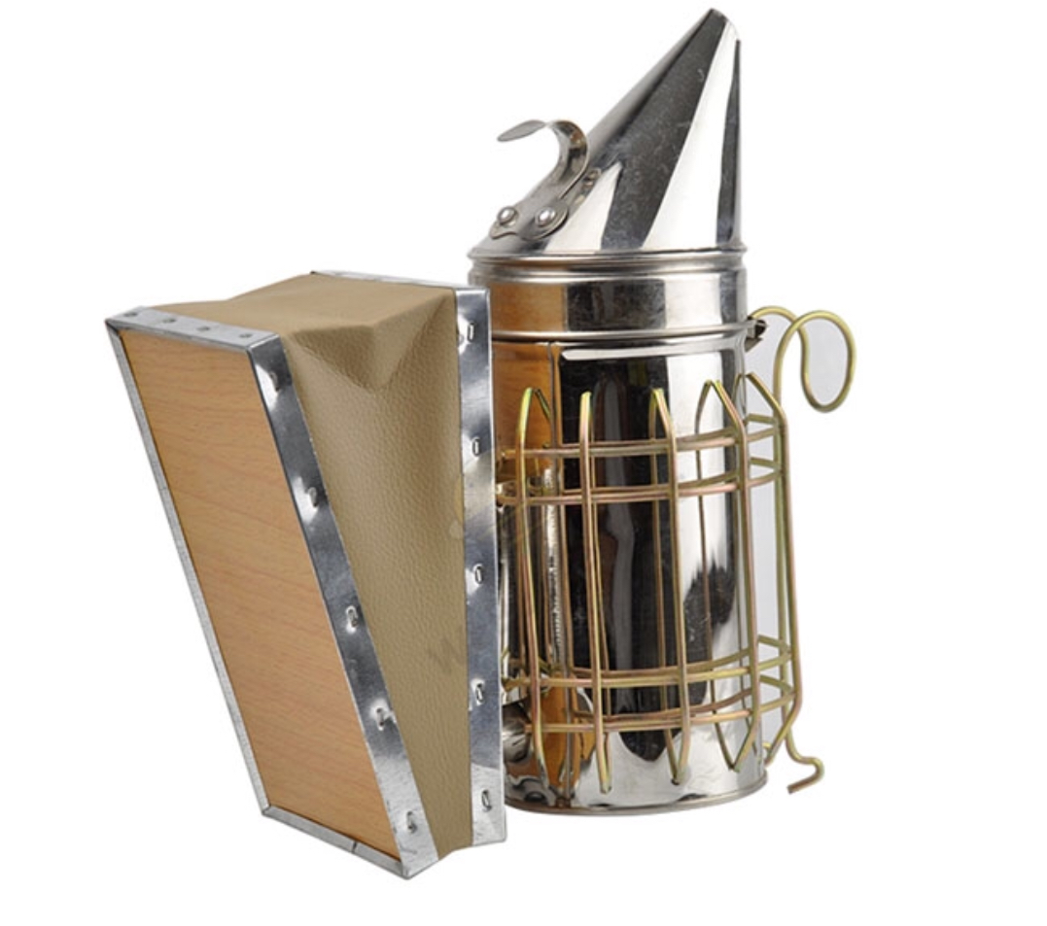
Smokers
Lightly smoking a hive interrupts the colony defensive reaction. It works by masking the alarm pheromones that might be released by guard bees or bees that are injured during an inspection.
It’s a good idea to smoke stings, even if they’re on your gloves, to mask alarm pheromone.
Don’t go overboard - too much smoke can rile up a colony.

Slide 17
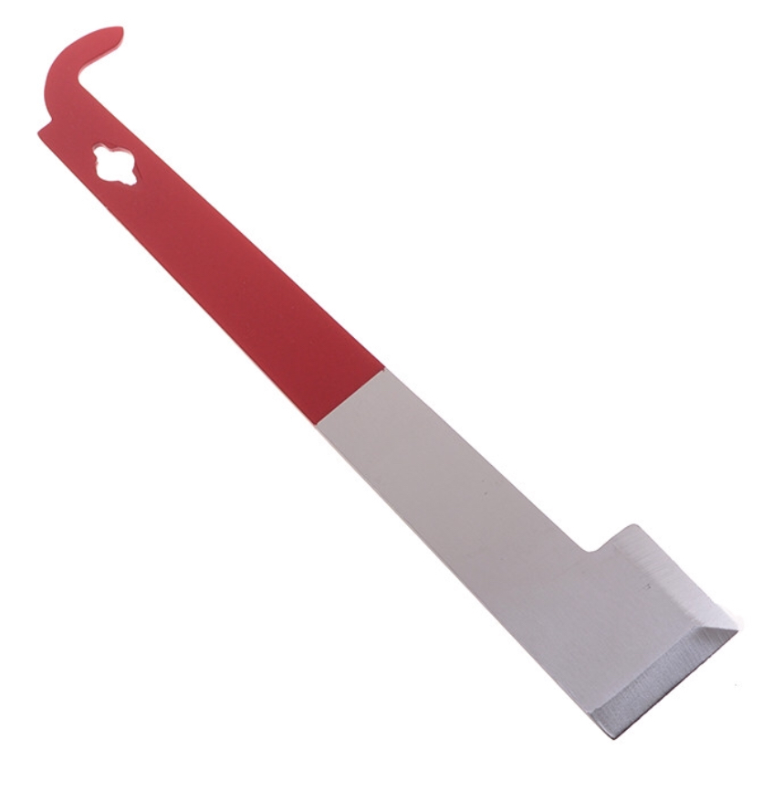
J-Hook Hive Tool
One of the most popular hive tool models
Very user friendly
Versatile

Slide 18
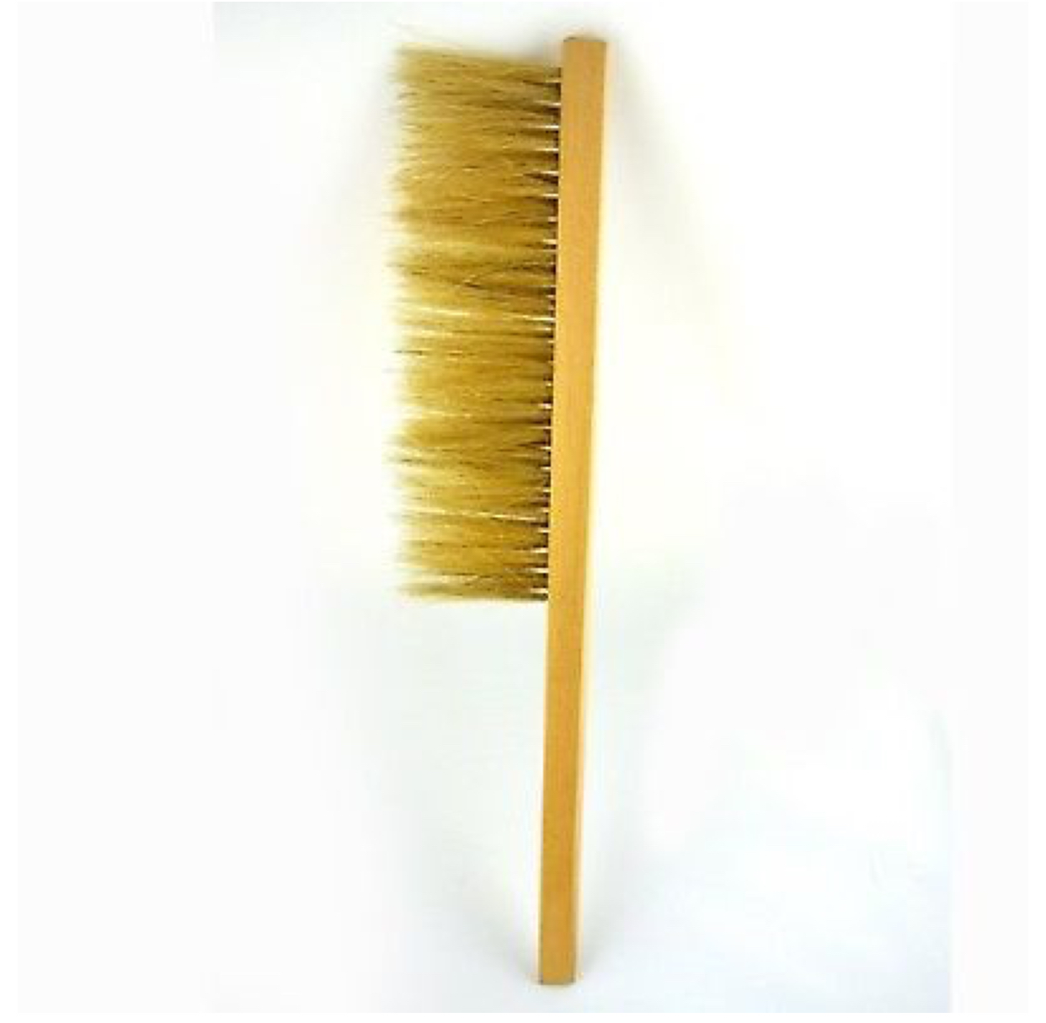
Bee Brush
An essential tool when used properly.
Short, flicking strokes will move the bees without damaging them.
Long, paint brush-like strokes will roll the bees over each other, at which point they will try to sting you.

Slide 19
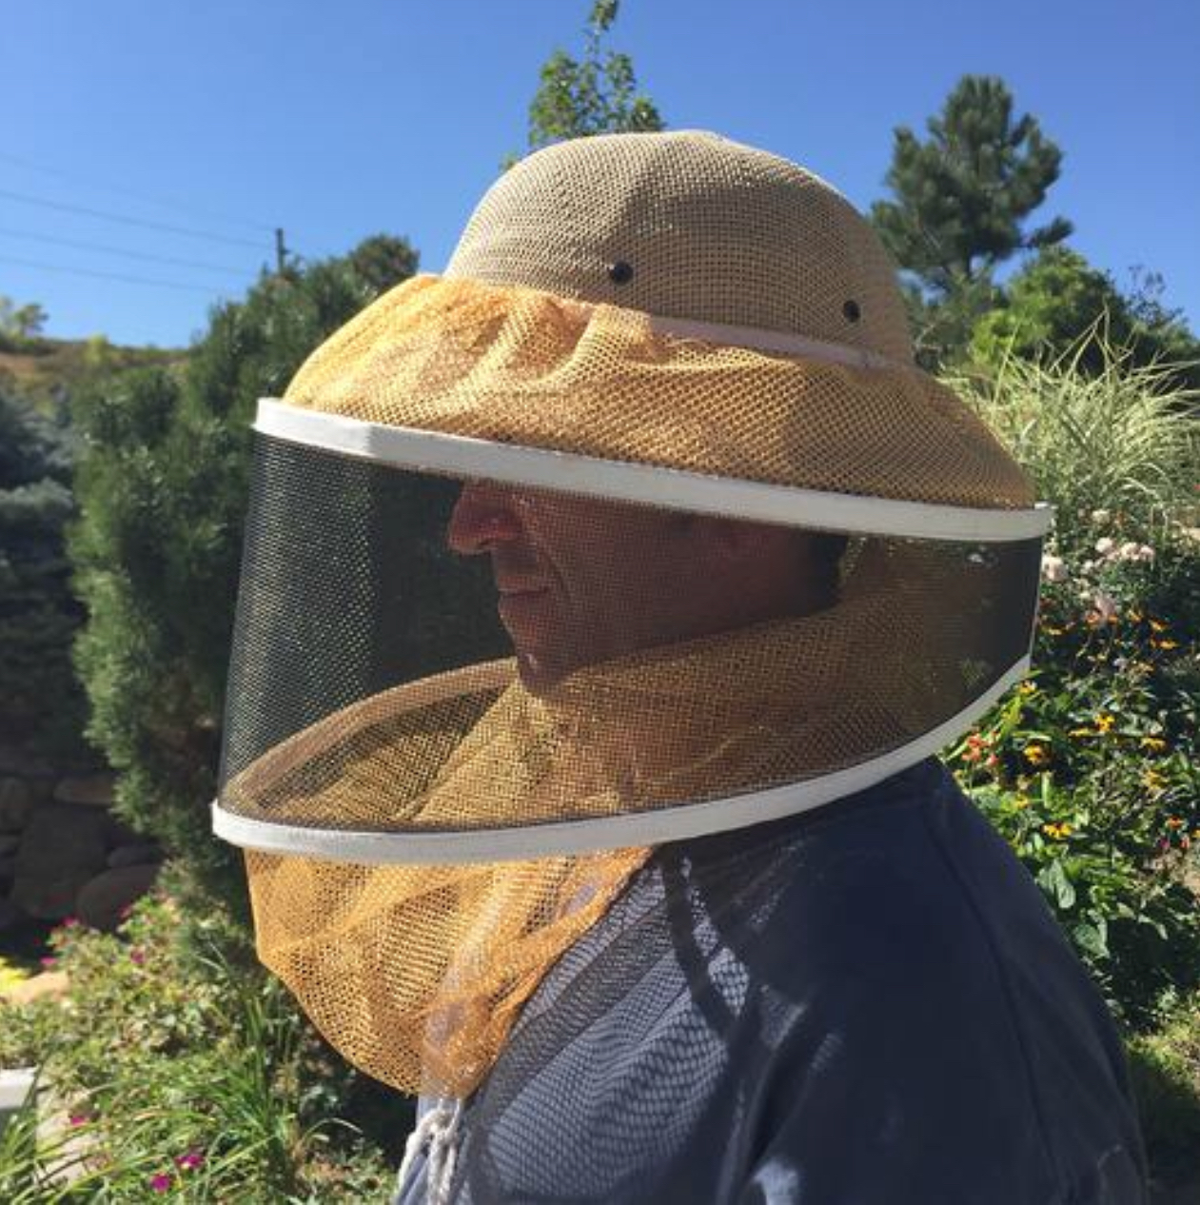
Protective Clothing
Protecting your face, especially your eyes, is very important.
Veils are the minimum amount of protection.
New beekeepers should always wear at least a veil.

Slide 20
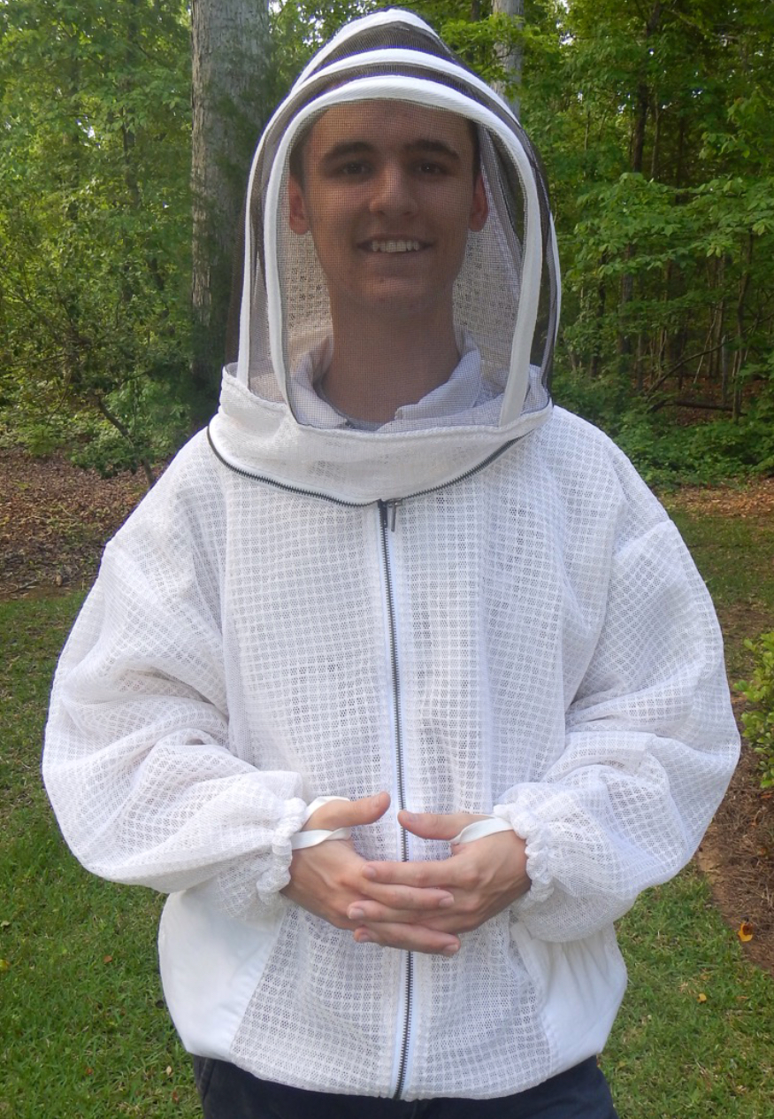
Ventilated Bee Jacket w/ Veil
A jacket with an attached veil is the second most protection, and is almost as popular as a full suit.
Mesh material allows for airflow and increases the thickness of the suit.

Slide 21
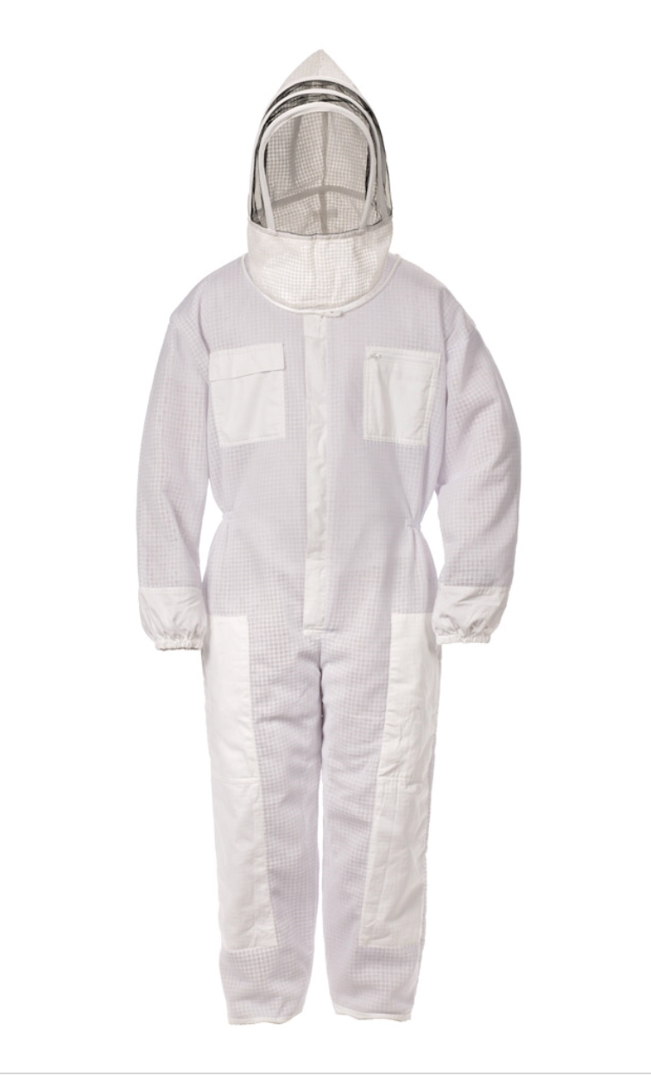
Ventilated Full Bee Suit
The full suit offers the most protection. It also has pockets for the various tools needed in the beeyard.
Zippers and the veil are more likely to fail on poorer quality suits.
Avoid suits or jackets that do not have a warranty, and do not use YKK zippers.

Slide 22
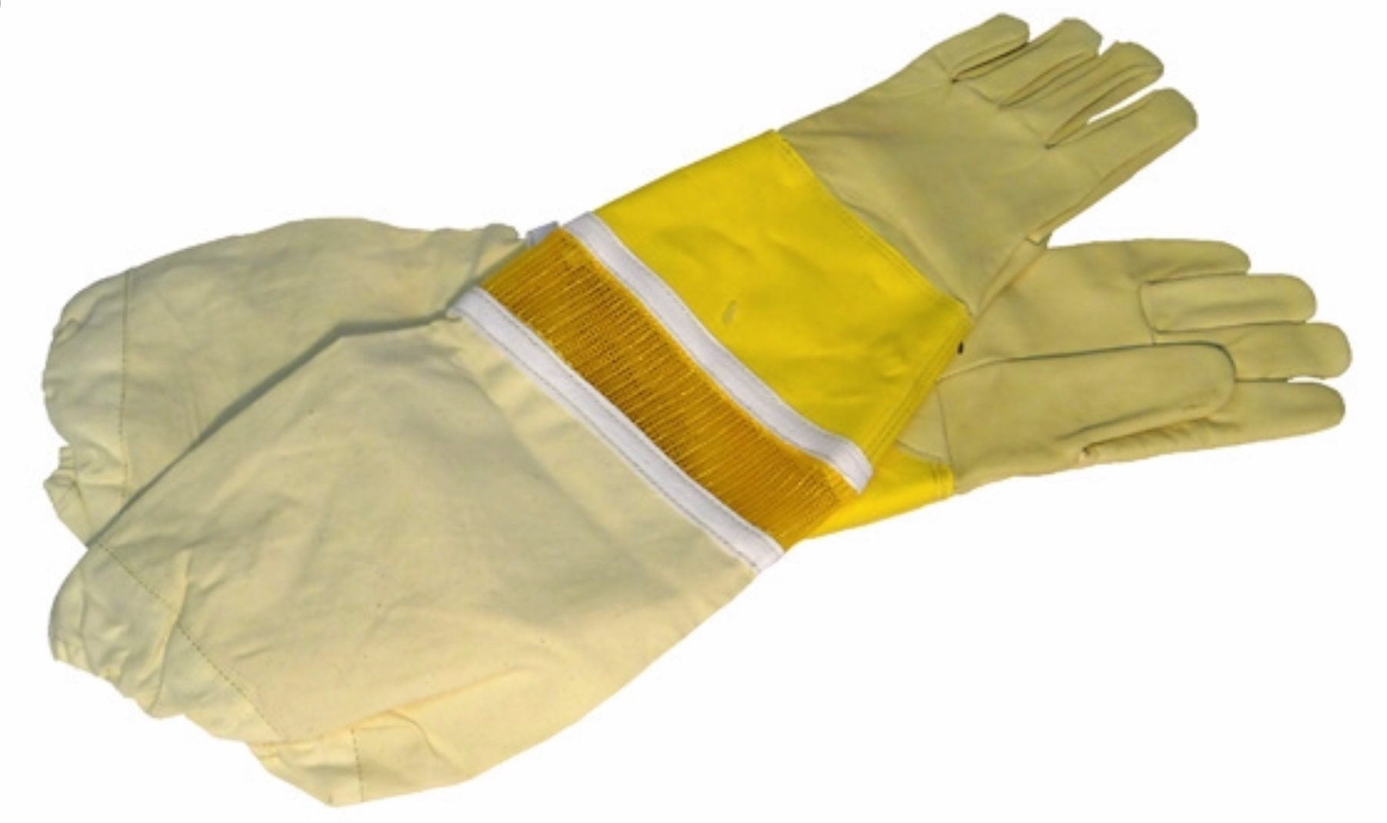
Beekeeping Gloves
No gloves are fully sting proof, but leather is very close.
If you don’t want to get stung in your fingers and hands, these are a must.

Slide 23
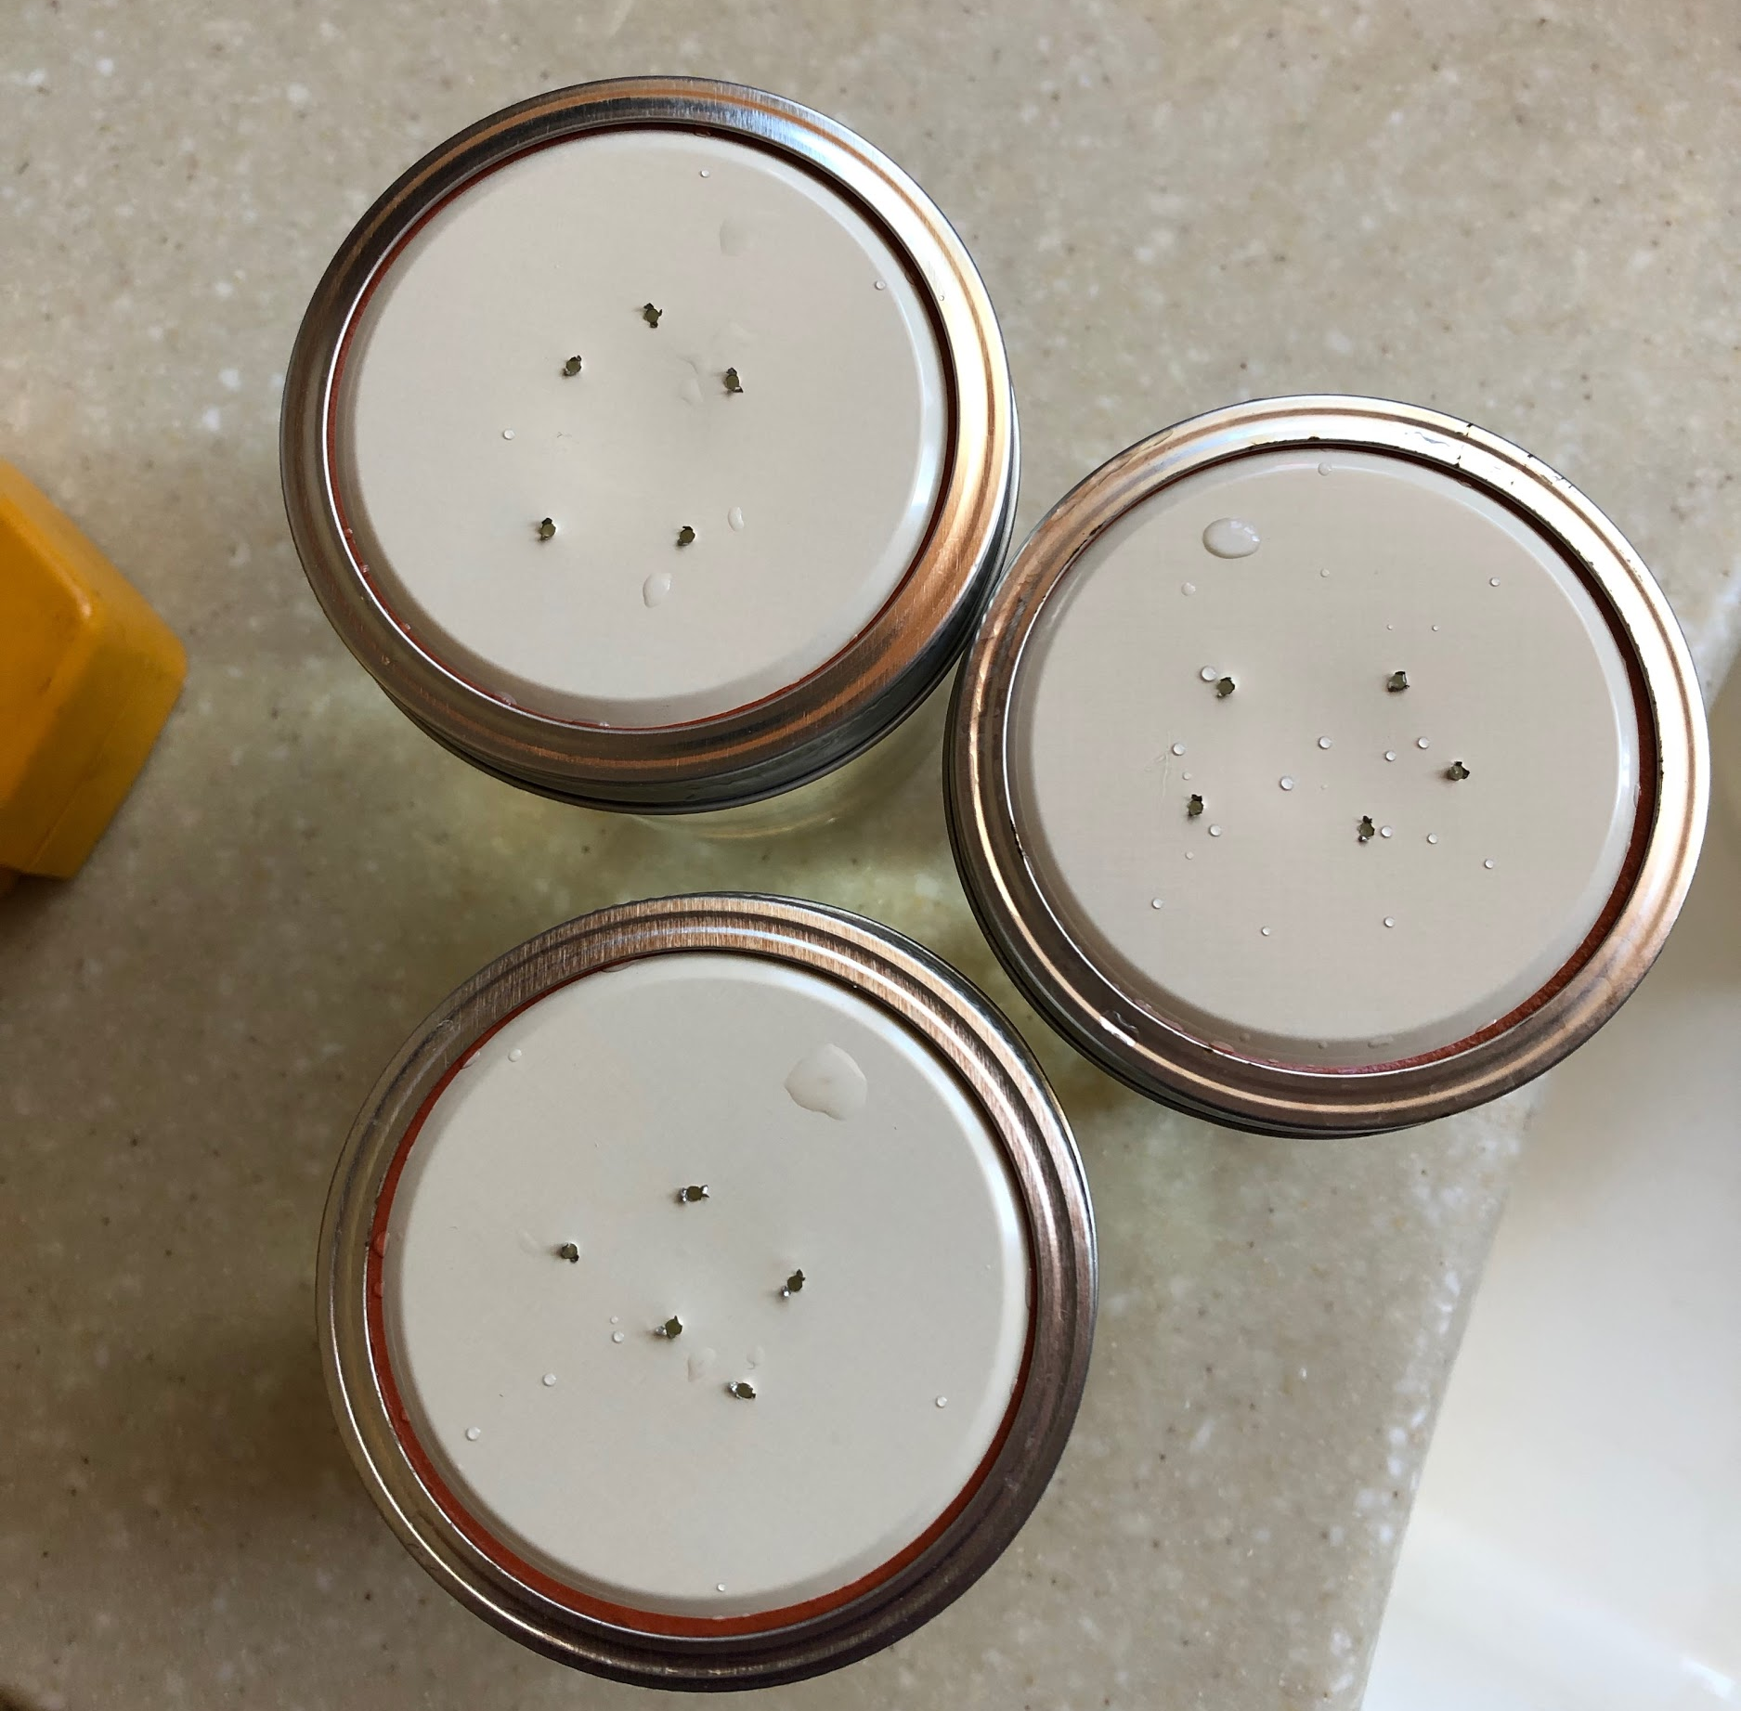
Mason Jar Feeder
The most foolproof method of feeding in the spring is an inverted jar (or bucket) placed over the hole in the inner cover.
Poke 5-10 holes with a small nail or thumbtack (drywall screws work great, too). Be sure the hole pattern matches the opening in your inner cover.
Syrup will not leak out.

Slide 24
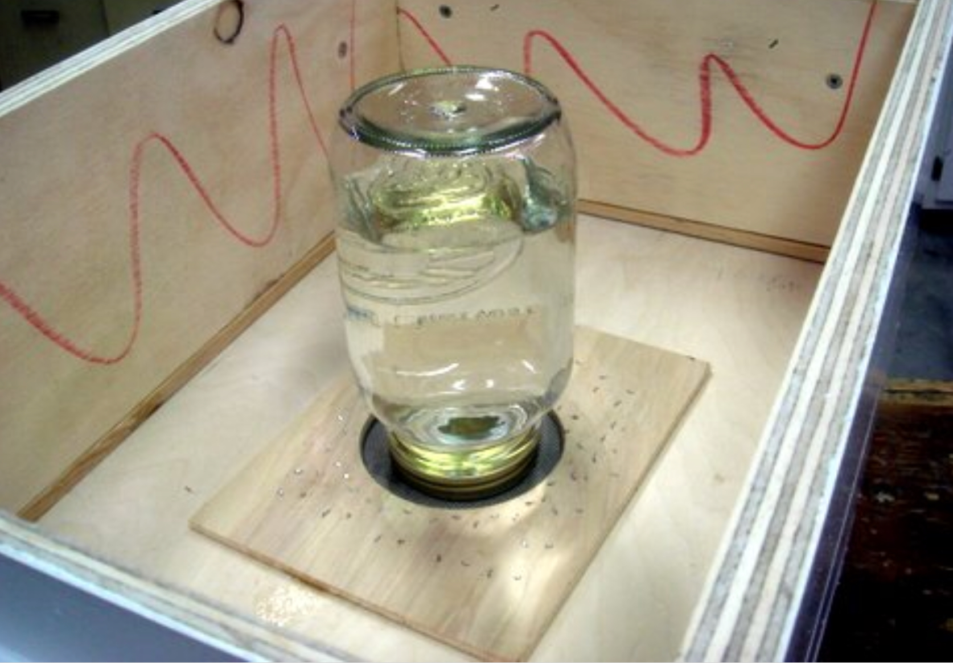
Trickle Feeding
Place an inverted jar directly over the hole in the inner cover.
Add a 2nd box.
Place the outer cover (lid) over the 2nd (top) box.
Larger containers can be used if the inner cover can withstand the weight. Be sure your container must be short enough fit completely under the outer cover (lid).

Slide 25
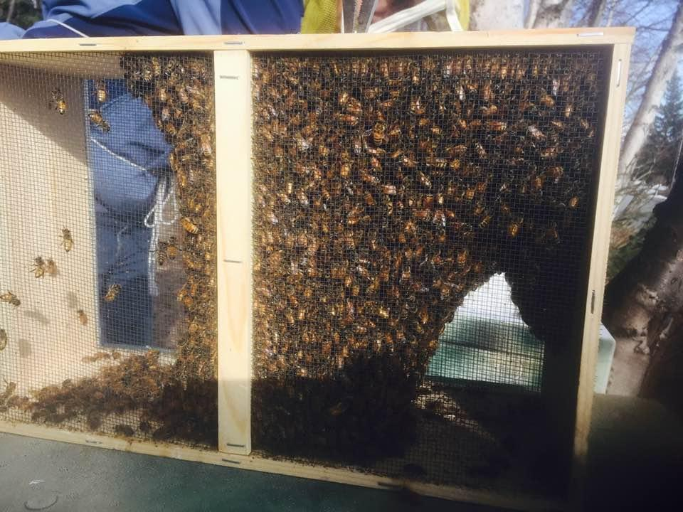
Installing a Package of Bees

Slide 26
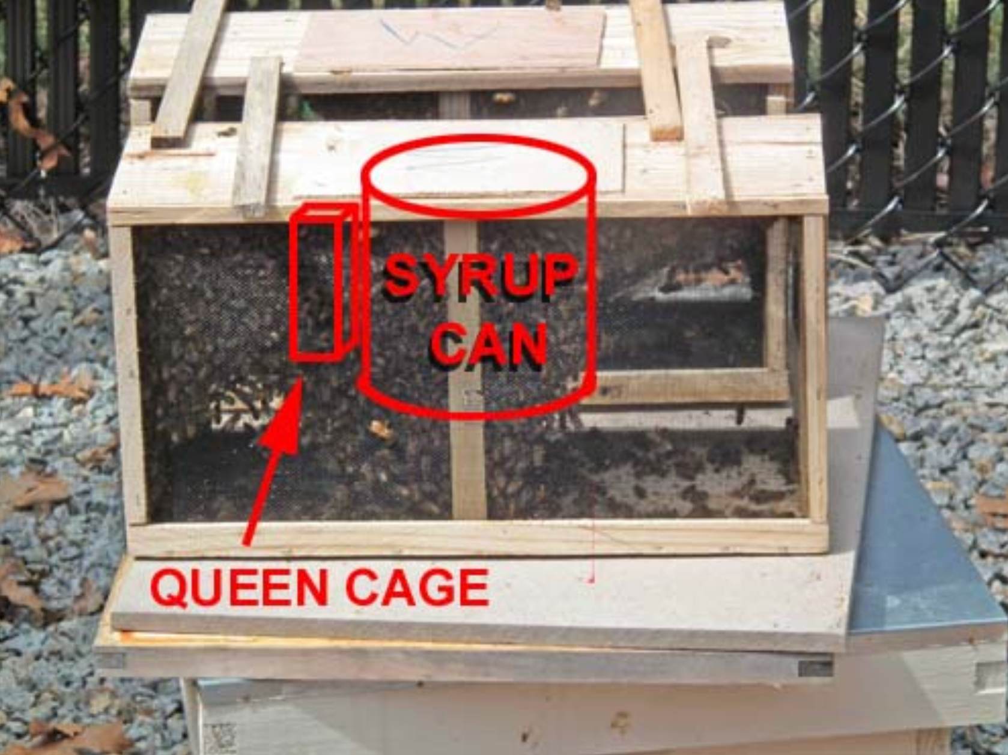
Typical Package
A feeder can with syrup will feed the bees in transit.
The queen will hang in a cage right next to the feeder can.

Slide 27
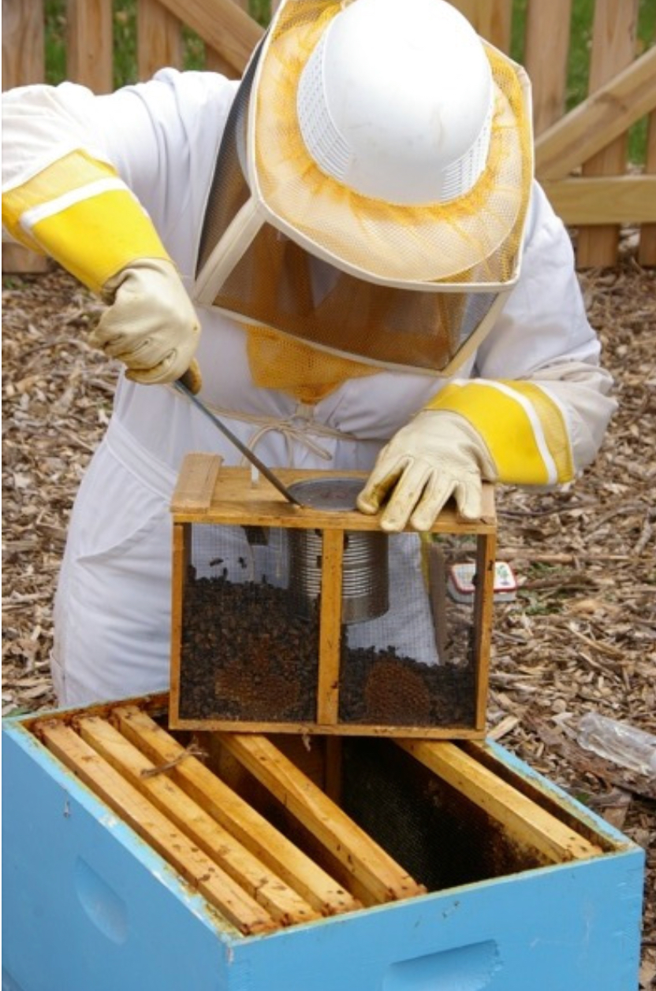
Remove the Feeder Can
Use your hive tool and a pair of vice grip pliers to securely grip the rim of the can, then slowly remove it.
Once the can is removed a few bees will come out.
This picture was taken somewhere warm (note the green grass behind the fence). In this picture, the bees have been sprayed with sugar water and shaken to the bottom of the box. Don’t do this in Alaska! Sugar water spray in cold weather chills the bees.

Slide 28
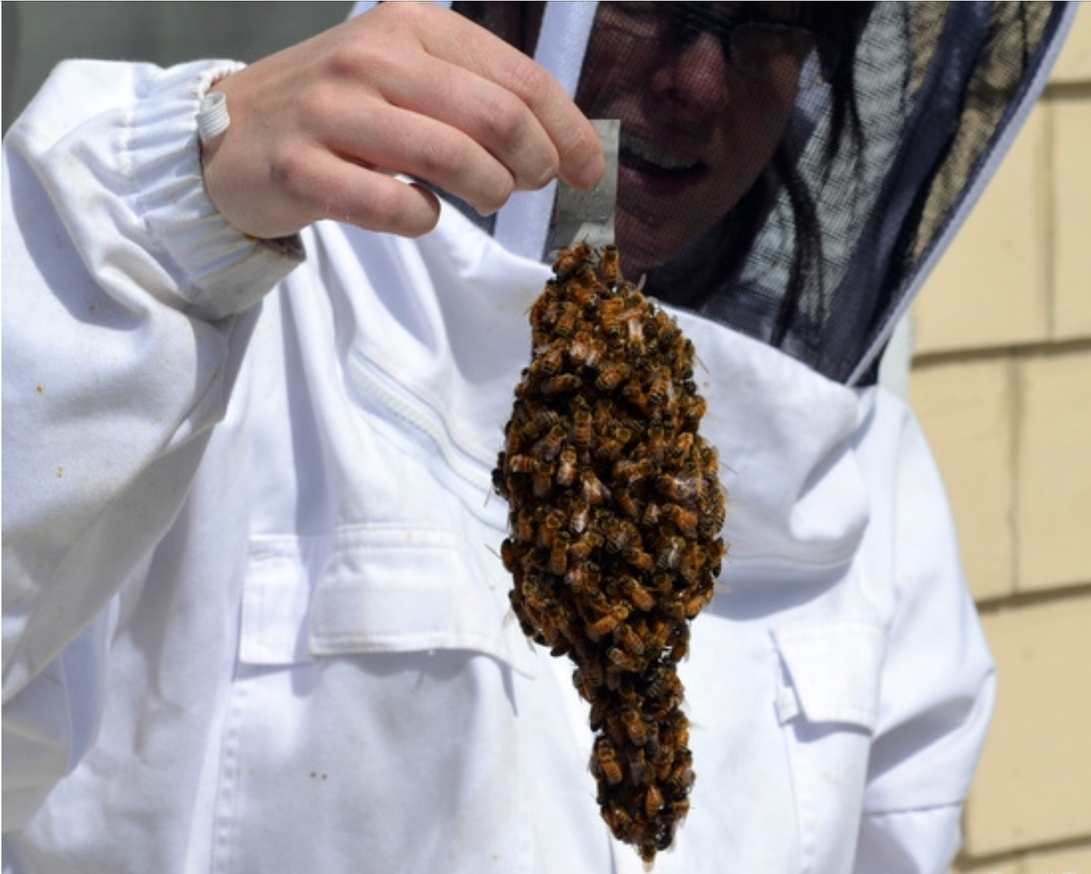
The Queen Cage
Most of the time, the queen is not related to the rest of the bees in the package. The cage protects her until they become accustomed to her scent.
Hundreds of bees may cluster around the queen cage when you remove it.
Hanging the caged queen in the hive prevents them from absconding; they will not leave without the queen.

Slide 29
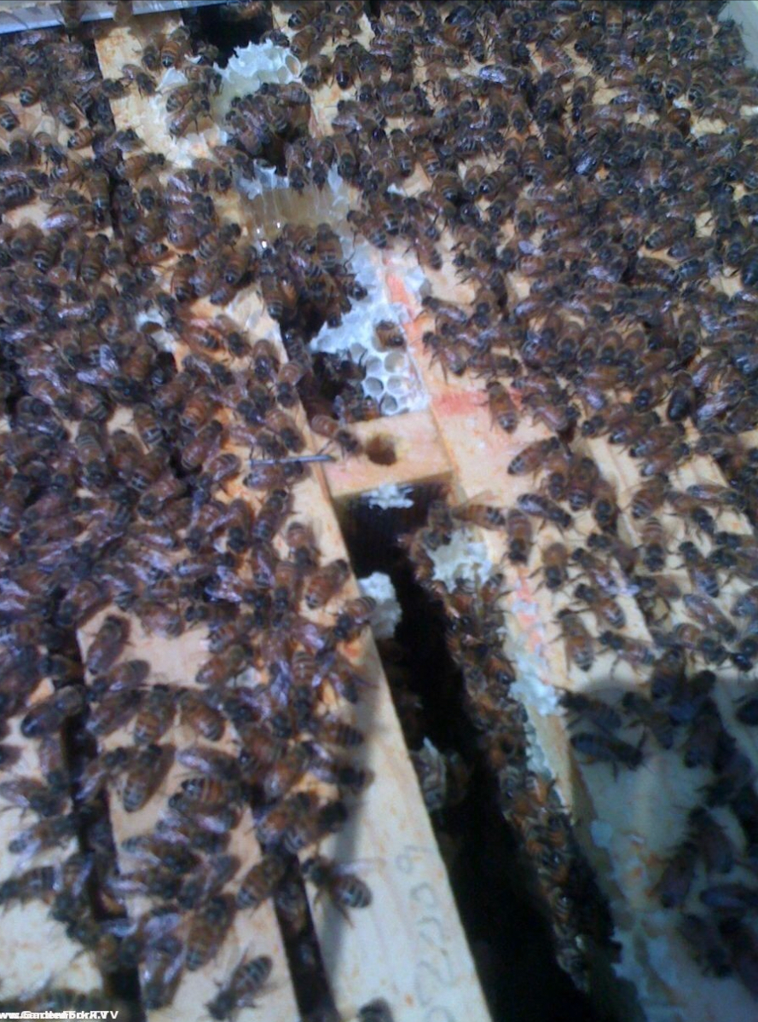
Hanging the Queen Cage
Hang the queen next to the hole in the inner cover so the bees cluster right under the feeder.
With drawn comb, squeeze two frames together until the cage embeds into both sides.
With undrawn frames, bend the top of the metal clip, and then hook it over a nail (or pencil, etc.).
Make sure he hole is pointing up so a dead attendant bee cannot plug it.
In this picture, the frames were too far apart. Bees filled the gap with burr comb that will have to be cleaned out later.

Slide 30
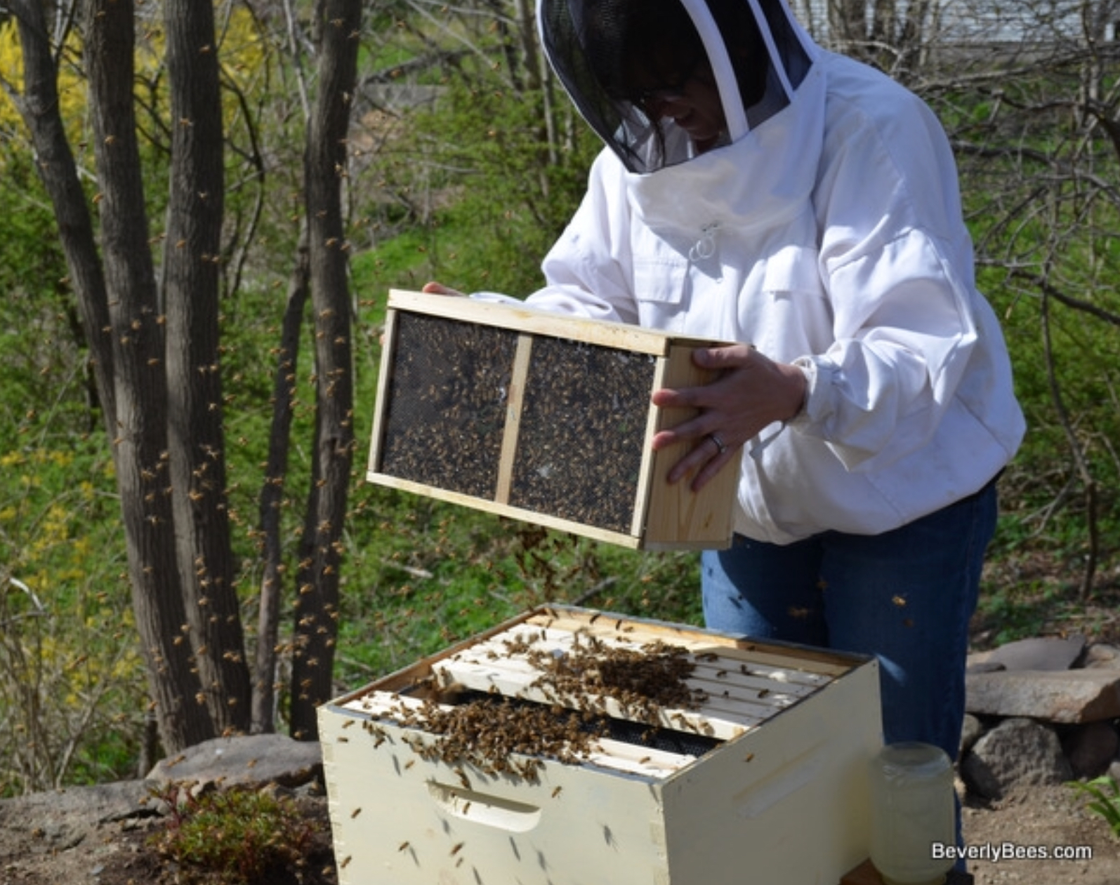
Shake Out Your Bees
There are many ways to get bees from the package your hive, but the safest way is to vigorously shake them directly in.
Warning: The “No Shake” Youtube videos were recorded in far warmer temperatures than you are going to have. Get them in quickly so they can cluster around the queen and start heating the cluster.

Slide 31
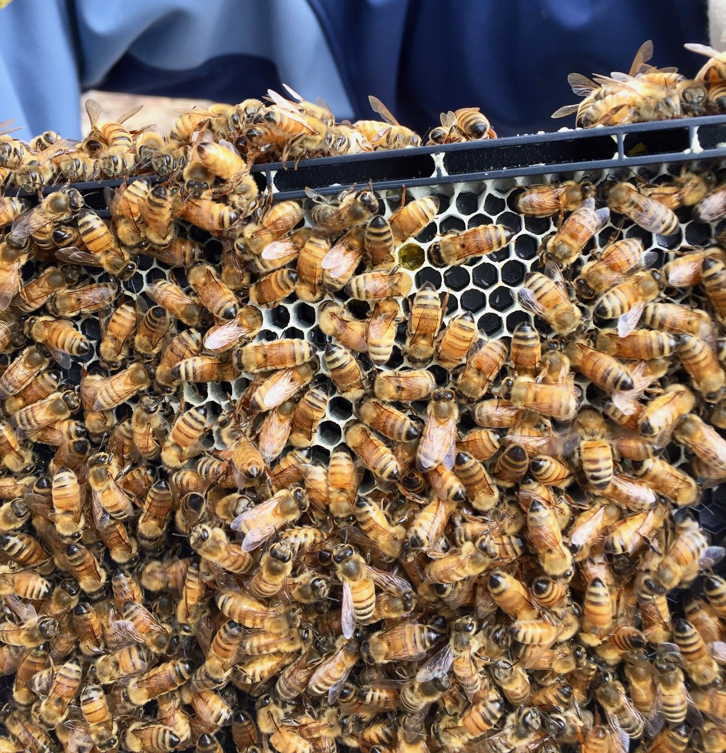
First Inspection
One week after releasing your queen, you’ll need to check for eggs.
Pull a frame from the middle of the cluster
Gently blow on an area to clear the bees
Eggs look like tiny rice grains.
When you find eggs or larvae, close up the hive and check again in 7-10 days.
Don’t prolong the inspection looking for the queen. It will be cool outside, and you don’t want to chill the brood.
If you don’t find eggs or larvae, contact your supplier as soon as possible.

Slide 32
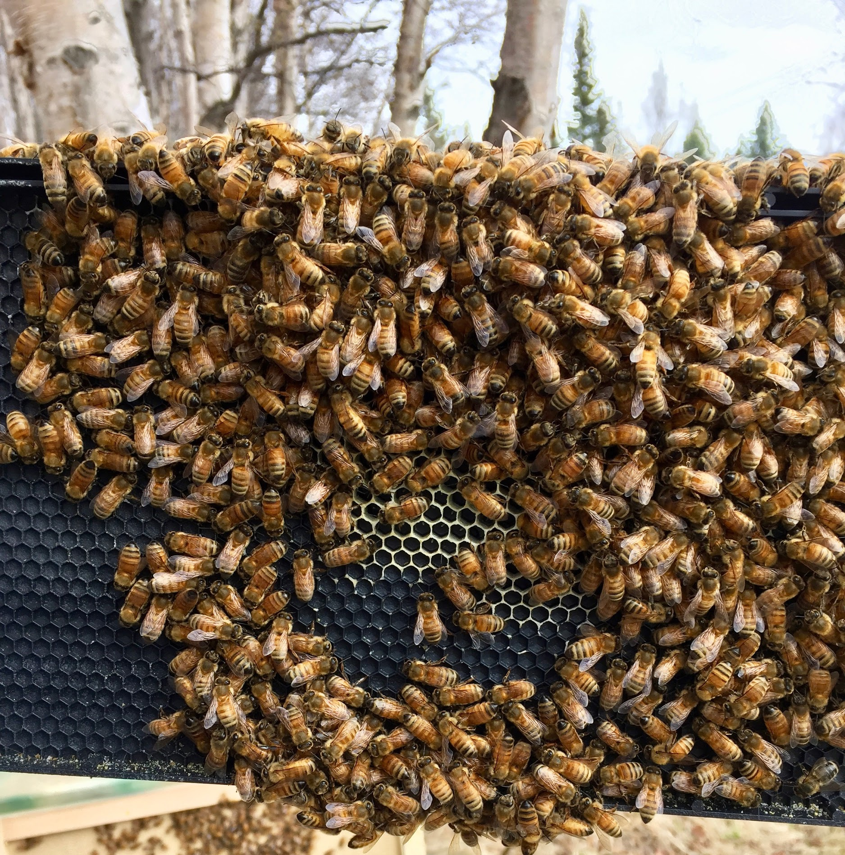
Newly Drawn Comb
The queen has already laid eggs in this comb, even though it’s barely drawn out.

Slide 33
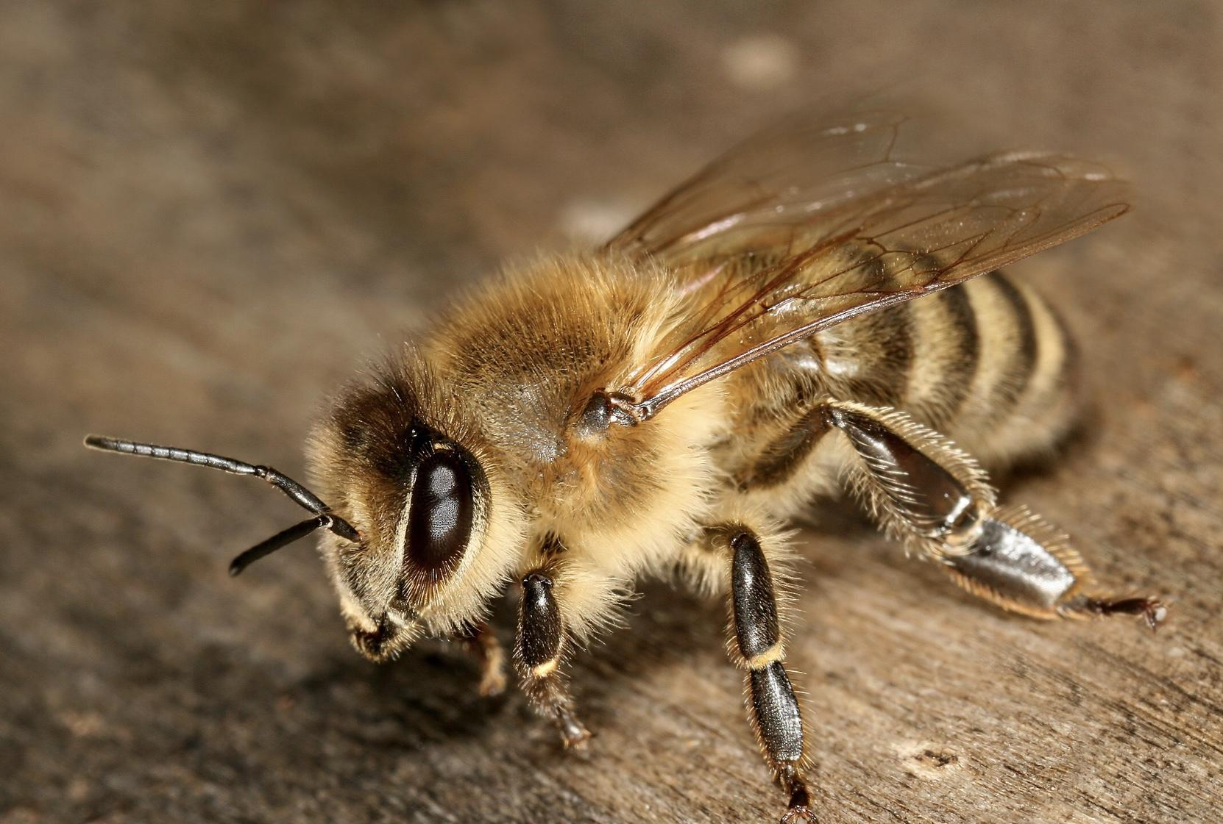
Worker, Drone, or Queen?

Slide 34
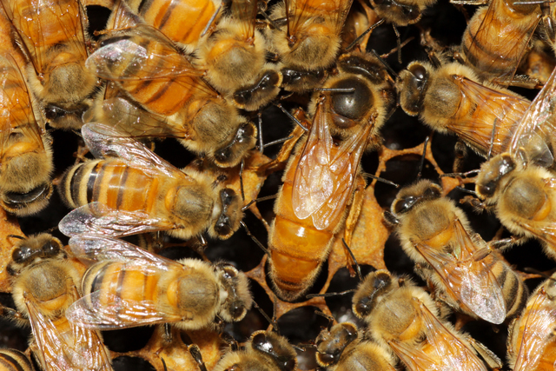
Worker, Drone, or Queen?

Slide 35
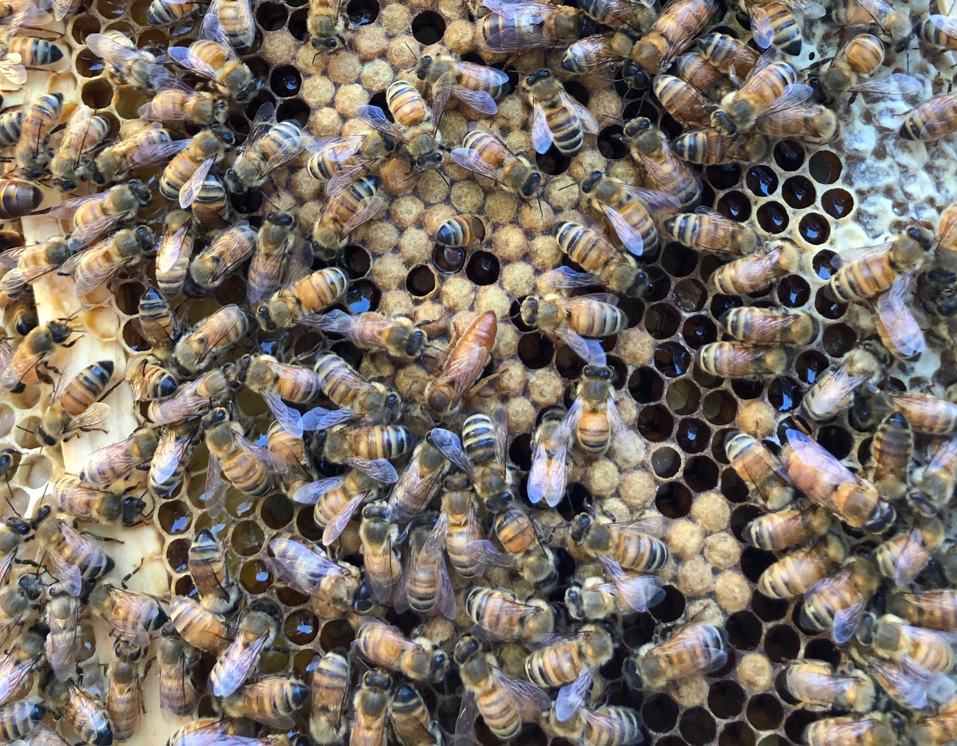
Worker, Queen, or Drone?

